Slide 1






WAYNE ENTERPRISES
Strategic Analysis Report
Executive Summary
Key Performance Indicators
Strategic Highlights
+18.2%
Aerospace Division Leading
Revenue Growth (2024)
24.2% market share with strong Q4 performance
HR Excellence
Employee Retention
94.9%
100% retention at senior levels, improving diversity
Innovation Pipeline
$2.1B
75 active projects, high commercialization potential
R&D Investment
Security Operations
Significant crime prevention improvements
Crime Reduction
-35%
Wayne Enterprises demonstrates exceptional performance across all divisions with strong financial growth,
outstanding human capital management, innovative R&D pipeline, and effective security operations.
The company is well-positioned for continued expansion and market leadership.
Confidential Analysis • Wayne Enterprises Board Report • 2024

Slide 2


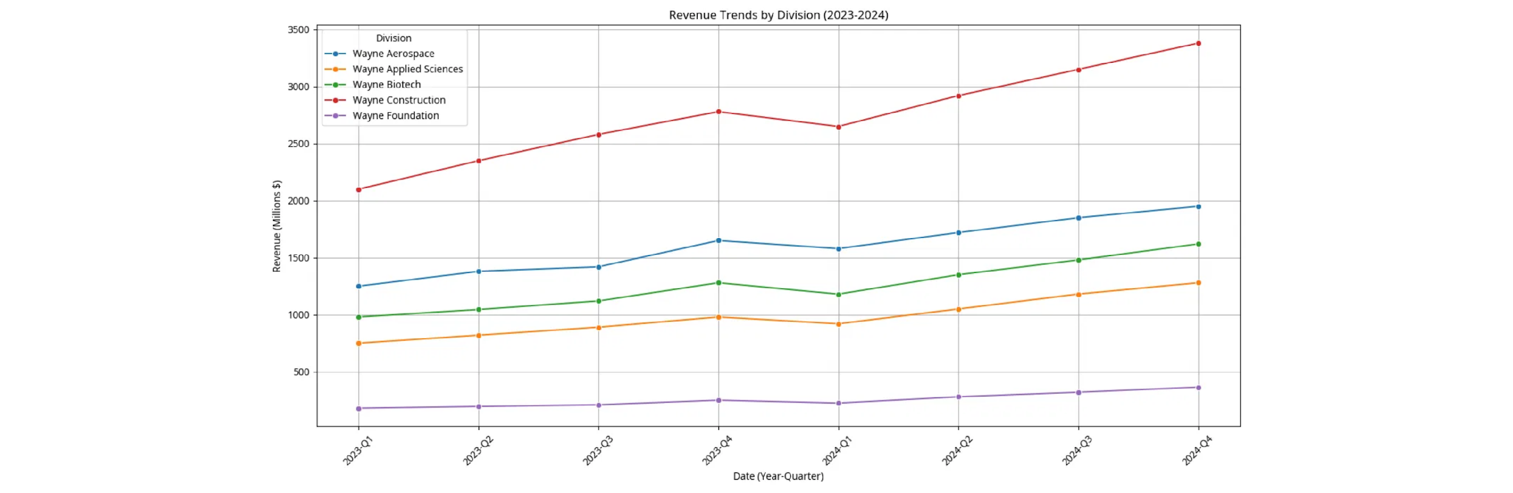
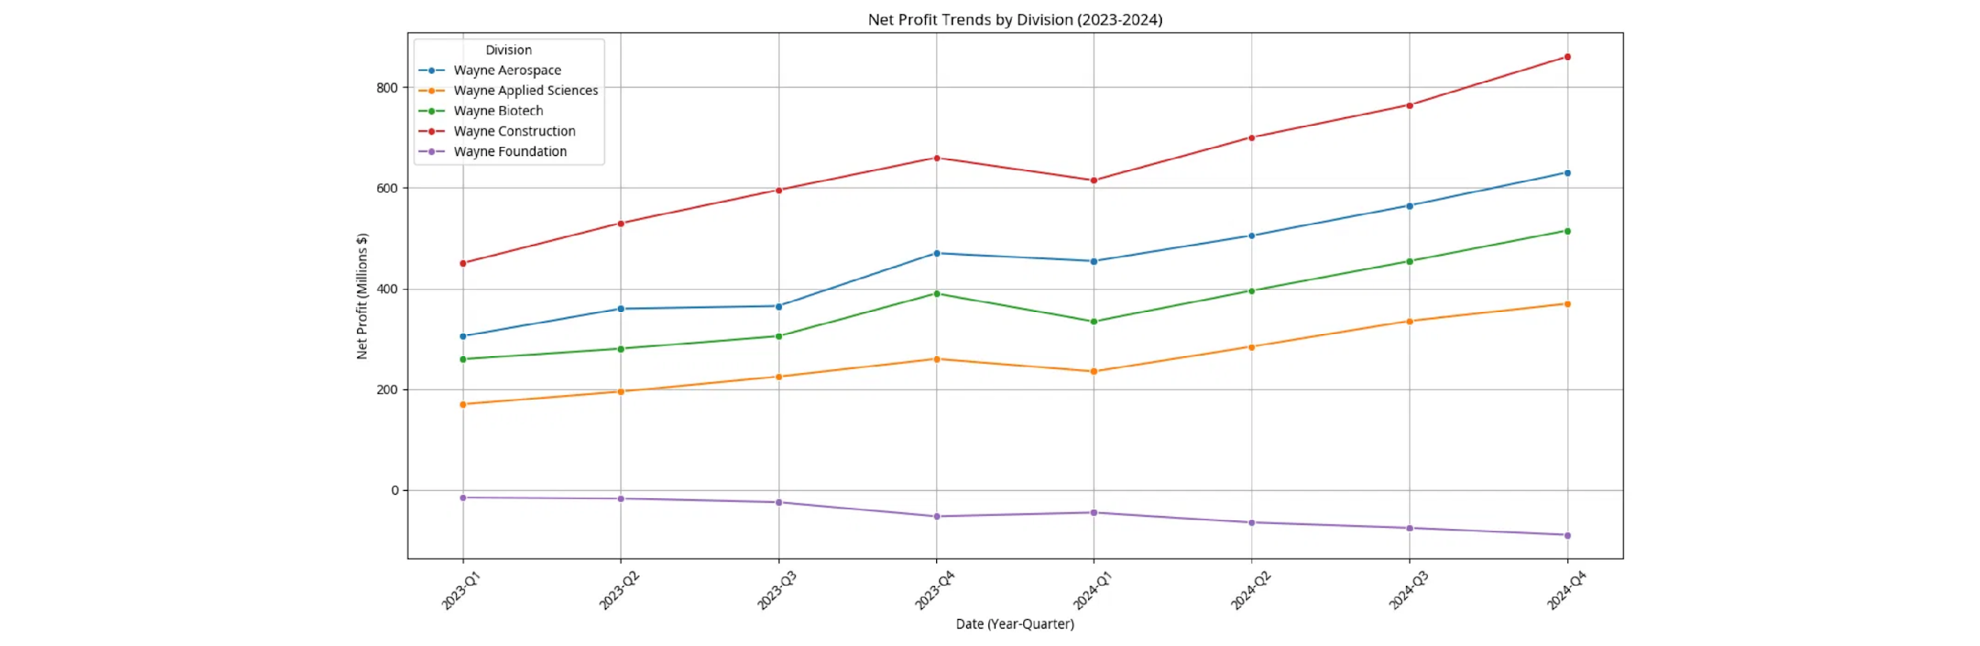
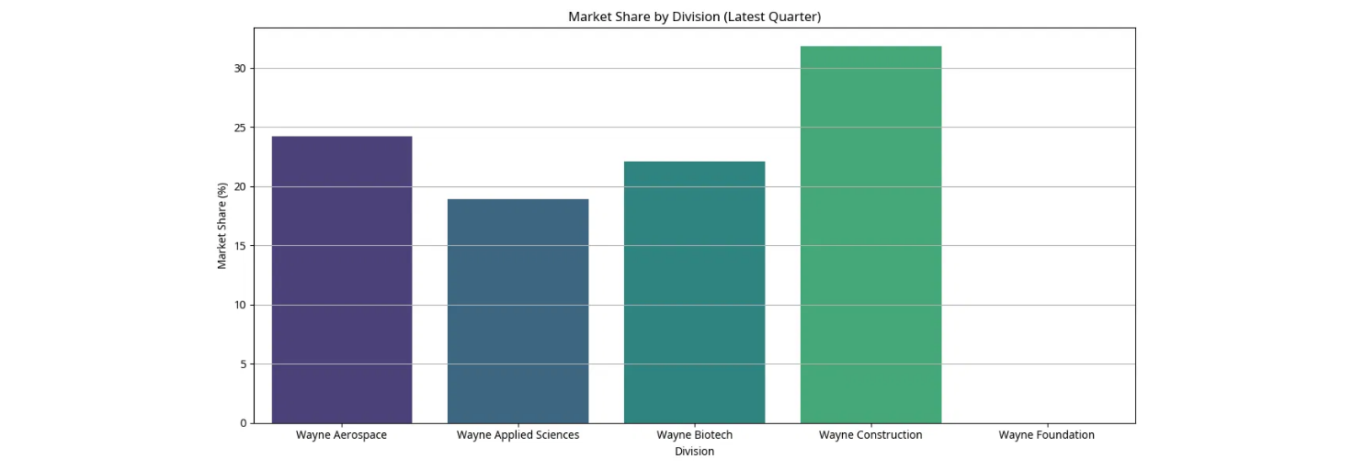

Financial Performance: Strong Growth Trajectory
Revenue and profit trends showing Wayne Aerospace and Construction leading growth, with Foundation operating as planned for social impact
Revenue Growth by Division
Q4 2024 Highlights
Wayne Aerospace
Revenue: $1.95B (+18%)
Profit: $630M (+34%)
Wayne Construction
Revenue: $3.38B (+21%)
Profit: $861M (+30%)
Wayne Biotech
Revenue: $1.62B (+27%)
Profit: $515M (+32%)
Applied Sciences
Key Insight:
Wayne Aerospace shows consistent upward trajectory with 24.2% market share in Q4 2024
Revenue: $1.28B (+31%)
Profit: $370M (+42%)
Net Profit Growth Trajectory
Market Leadership
Customer Satisfaction
4.6/5.0
R&D Investment
12.8% of Revenue
YoY Growth
+18.2%
Strategic Note:
Foundation's planned losses support social impact initiatives while other divisions drive profitability
Strategic Insight:
All profit-generating divisions show accelerating growth with strong market positions,
while Foundation's social investments align with long-term sustainability goals.

Slide 3


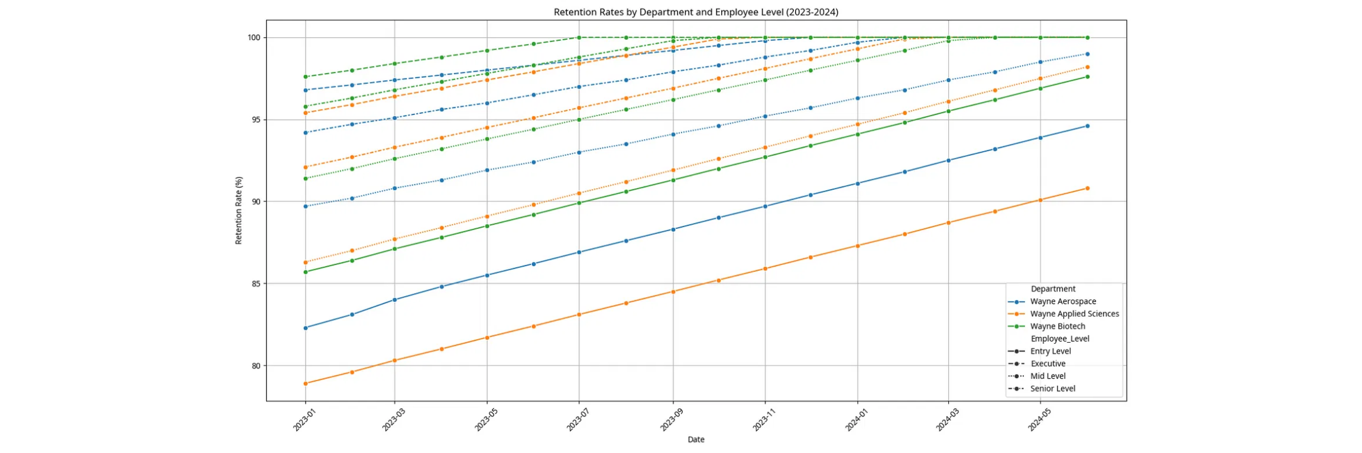
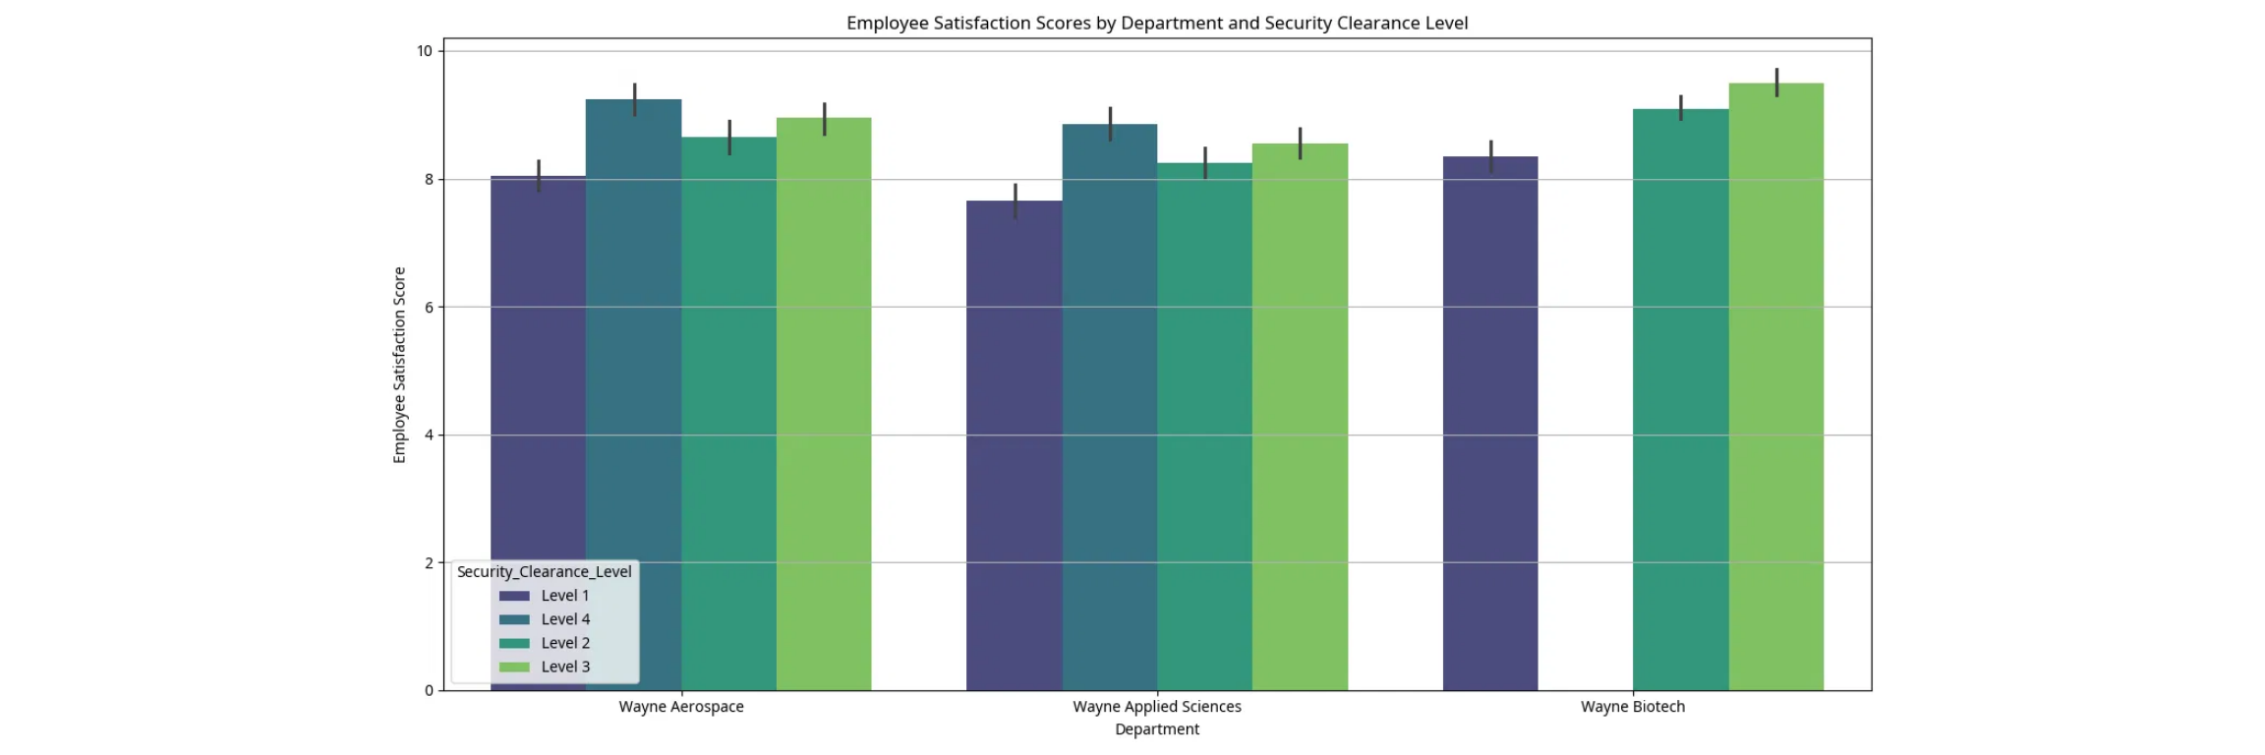
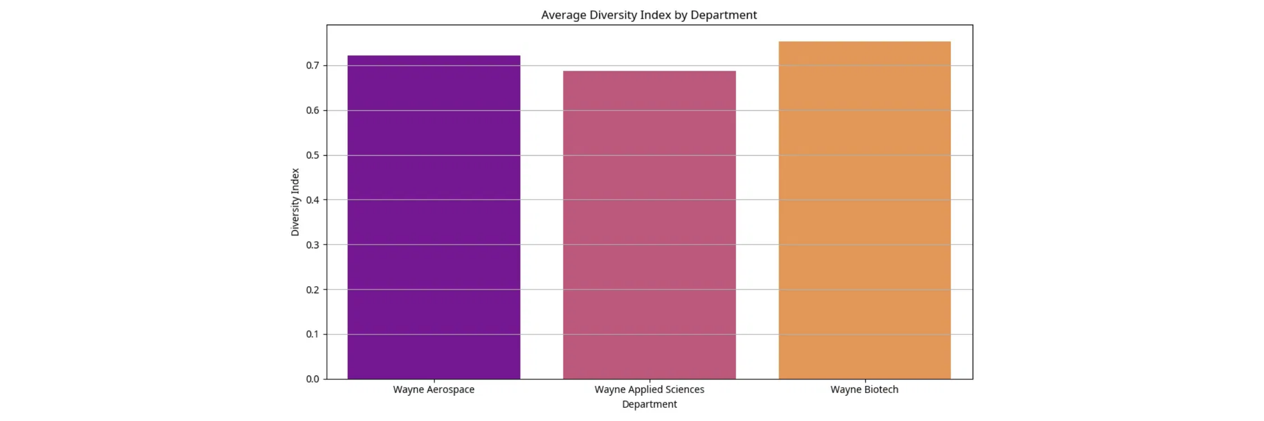






Human Capital Excellence
Outstanding retention rates, improving diversity metrics, and strong correlation between security clearance levels and employee satisfaction
Retention Excellence Across All Levels
Security Clearance & Satisfaction
Key Finding:
Executive Level
Senior Level
Higher security clearance levels correlate with increased employee satisfaction across all departments
100% Retention
99.7% Retention
Diversity & Inclusion Progress
Key HR Metrics
Overall Retention
94.9%
Avg Performance Rating
5.2/6.0
Training Hours/Year
165
Internal Promotions
18/month
Wayne Biotech
0.82 Index
Wayne Aerospace
0.75 Index
Employee Satisfaction
8.7/10
Strategic Insight:
Wayne Enterprises maintains industry-leading retention rates with continuous improvement in diversity metrics.
The correlation between security clearance and satisfaction indicates strong employee trust and engagement.

Slide 4


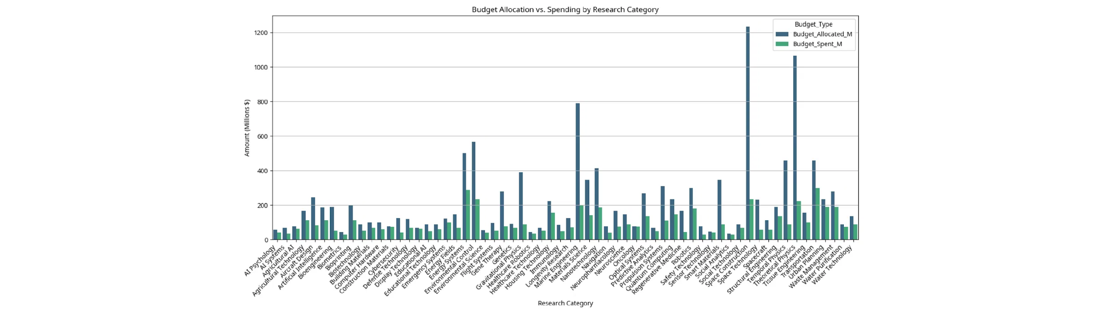
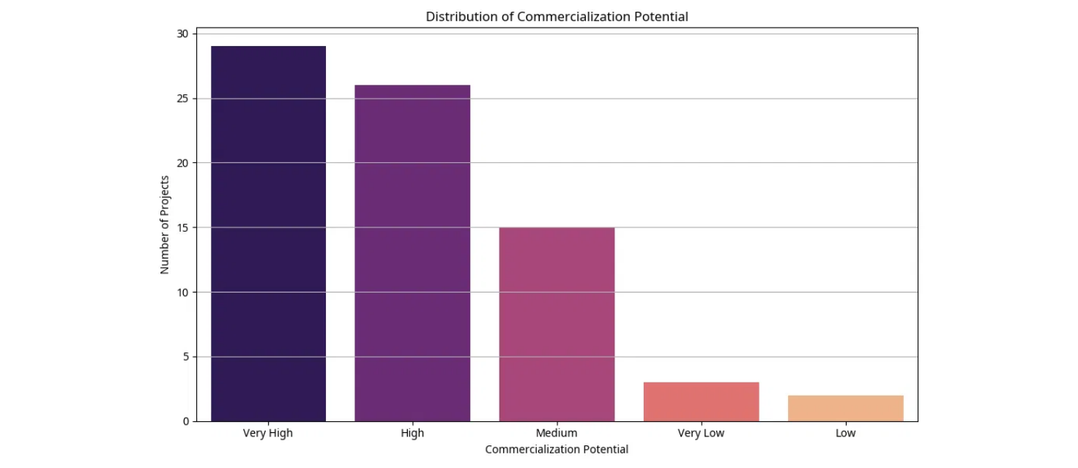
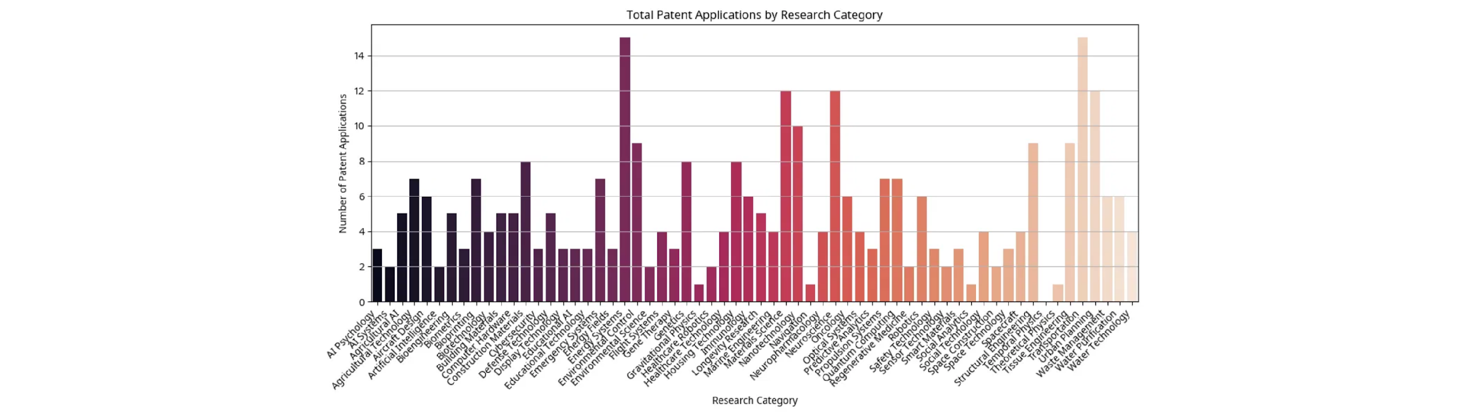





R&D Innovation Pipeline
High-potential projects in neural interfaces, quantum computing, and fusion power with strong patent portfolio and commercialization prospects
R&D Investment by Category
Innovation Metrics
75
Active Projects
68%
Timeline Adherence
245
Total R&D Investment:
$2.1B across 75 active projects with focus on high-impact technologies
Patent Applications
42%
High Commercial Potential
Commercial Potential
Patent Applications by Research Category
Very High
18 projects
High
14 projects
Medium
25 projects
Defense Tech
Quantum Computing
Neural Interfaces
52 Patents
38 Patents
31 Patents
Breakthrough Projects
Neural Interface
Quantum Computing
Fusion Power
Defense Systems
$234M Investment
$189M Investment
$156M Investment
$298M Investment
Strategic Insight:
Wayne Enterprises' R&D portfolio demonstrates strong focus on next-generation technologies
with 42% of projects showing high commercialization potential and robust patent protection.

Slide 5


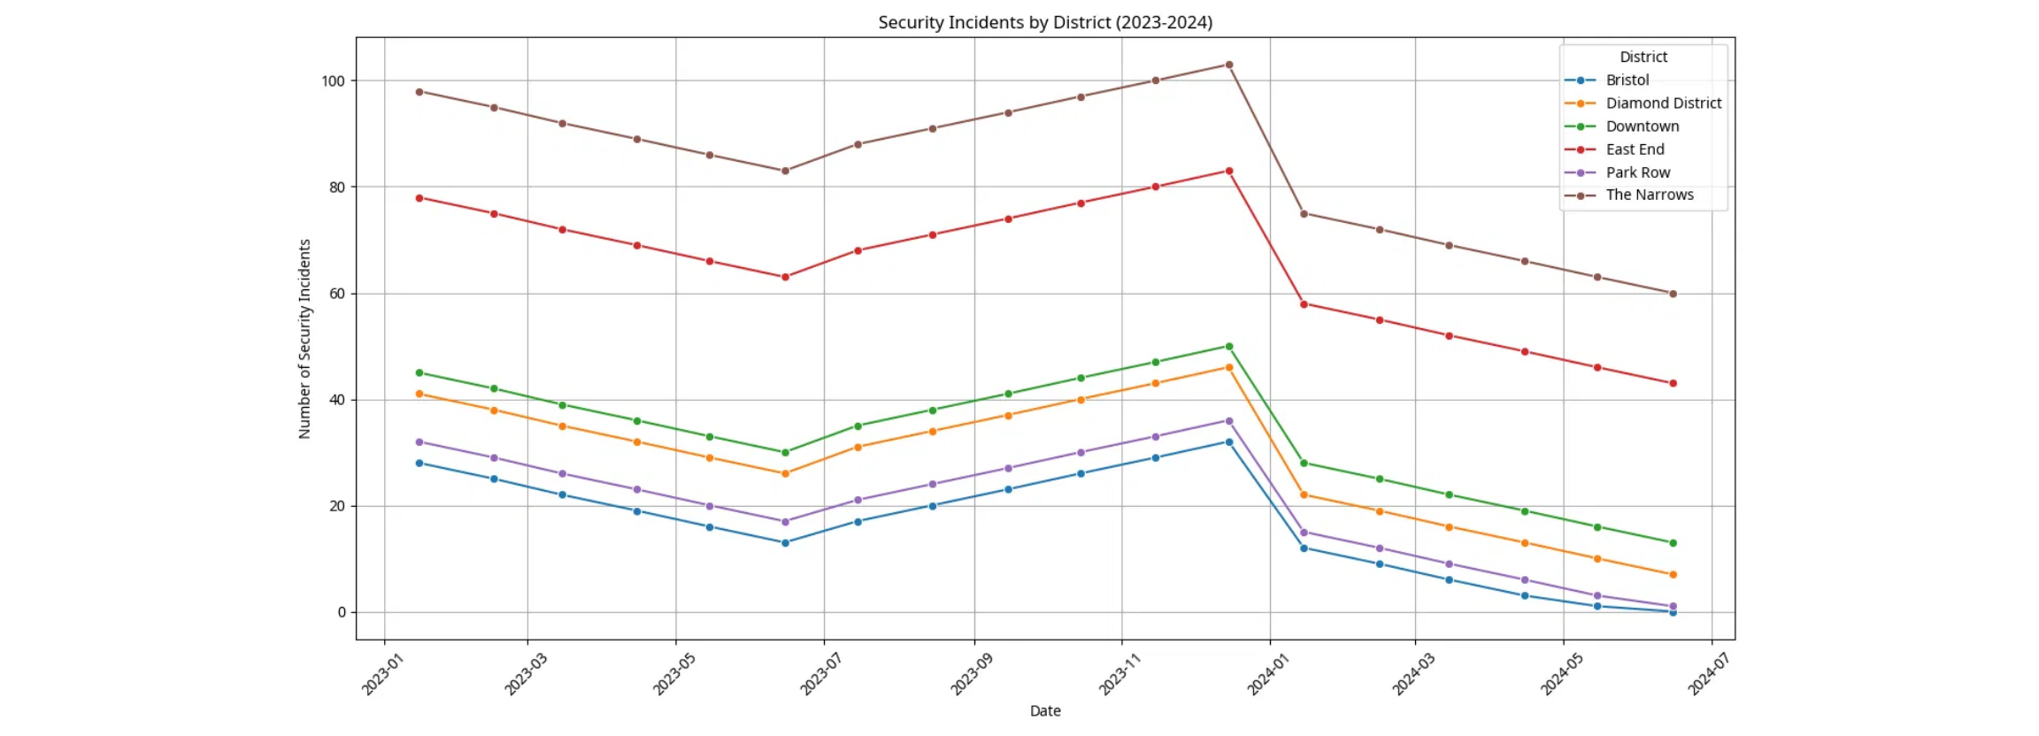
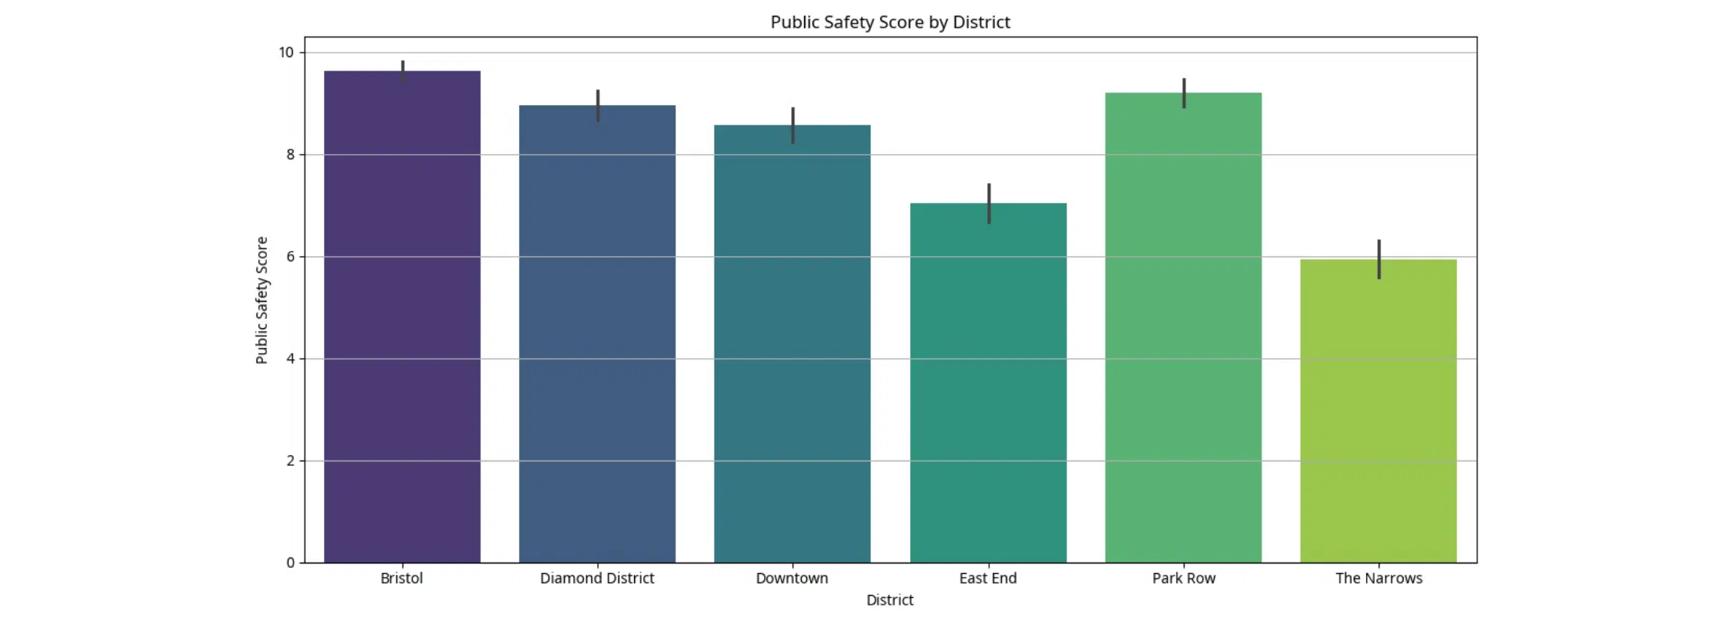
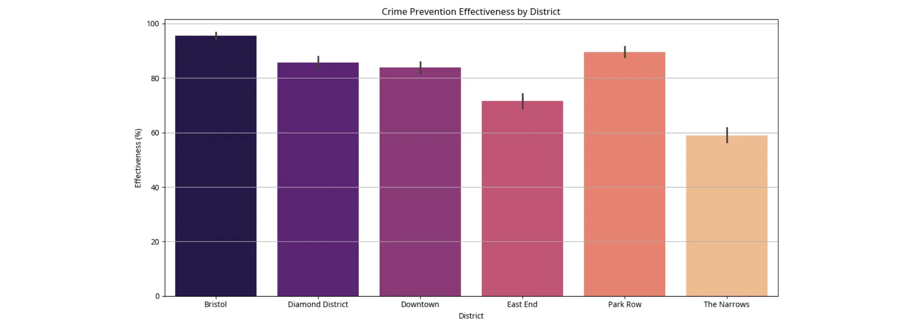





Gotham Security Operations: Crime Prevention Success
Significant improvement in crime prevention effectiveness across districts, with Bristol and Park Row showing exceptional results
Security Incidents Reduction
Public Safety Performance
Key Achievement:
35% overall reduction in security incidents across all districts in 2024
Bristol
Park Row
9.8/10 Safety Score
8.5/10 Safety Score
Prevention Effectiveness by District
Security Operations Metrics
Avg Response Time
3.2 min
Wayne Tech Deployments
1,247
Infrastructure Investment
$156M
Community Events
142
Best Performers:
Bristol (92.3%) and Park Row (85.3%) lead in crime prevention effectiveness
Employee Safety Index
8.9/10
District Performance Summary
Bristol
Park Row
Downtown
East End
The Narrows
Otisburg
Incidents: -45%
Incidents: -38%
Incidents: -28%
Incidents: -22%
Incidents: -15%
Incidents: -18%
Response: 2.1 min
Response: 2.9 min
Response: 3.2 min
Response: 4.8 min
Response: 6.2 min
Response: 5.1 min
Strategic Insight:
Wayne Tech deployments and community engagement initiatives have significantly improved
public safety across all districts, with The Narrows requiring continued focused investment.

Slide 6


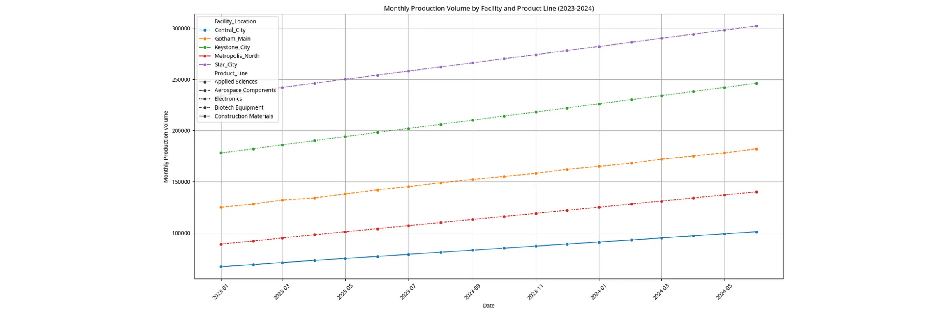
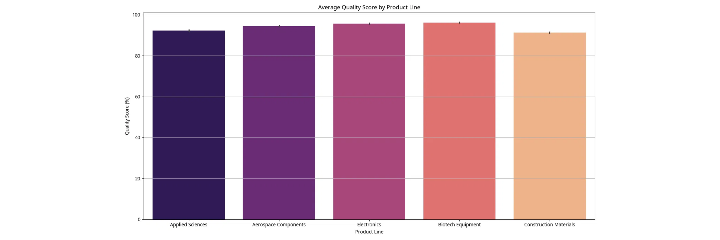
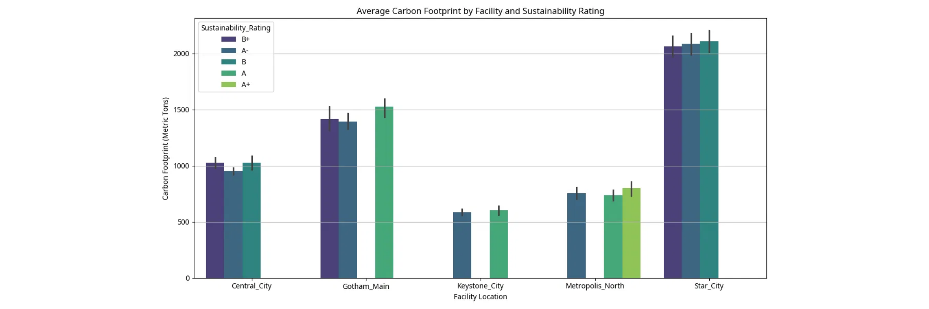





Supply Chain Optimization
Gotham Main and Metropolis North facilities leading in performance with ongoing sustainability improvements across all operations
Production Volume Trends
Quality Scores by Product Line
Quality Excellence:
Gotham Main
Metropolis North
All product lines maintain >92% quality scores with Biotech leading at 96.8%
302K units/month
285K units/month
Sustainability & Carbon Footprint
Operational Excellence
Avg Quality Score
94.2%
Avg Lead Time
18 days
Disruptions/Month
2.3
Inventory Turnover
8.2x
A-Rated Facilities
Carbon Reduction
3 out of 5
-12% YoY
Cost Per Unit
$142
Facility Performance Comparison
Gotham Main
Metropolis North
Central City
Star City
Coast City
Aerospace
Biotech
Applied Sciences
Construction
Mixed Production
96.8% Quality
95.2% Quality
93.1% Quality
92.4% Quality
91.7% Quality
A+ Sustainability
A Sustainability
B+ Sustainability
B Sustainability
B- Sustainability
Strategic Insight:
Supply chain operations demonstrate strong performance with Gotham Main and Metropolis North
leading in both quality and sustainability metrics. Continued focus on carbon reduction initiatives shows measurable progress.

Slide 7


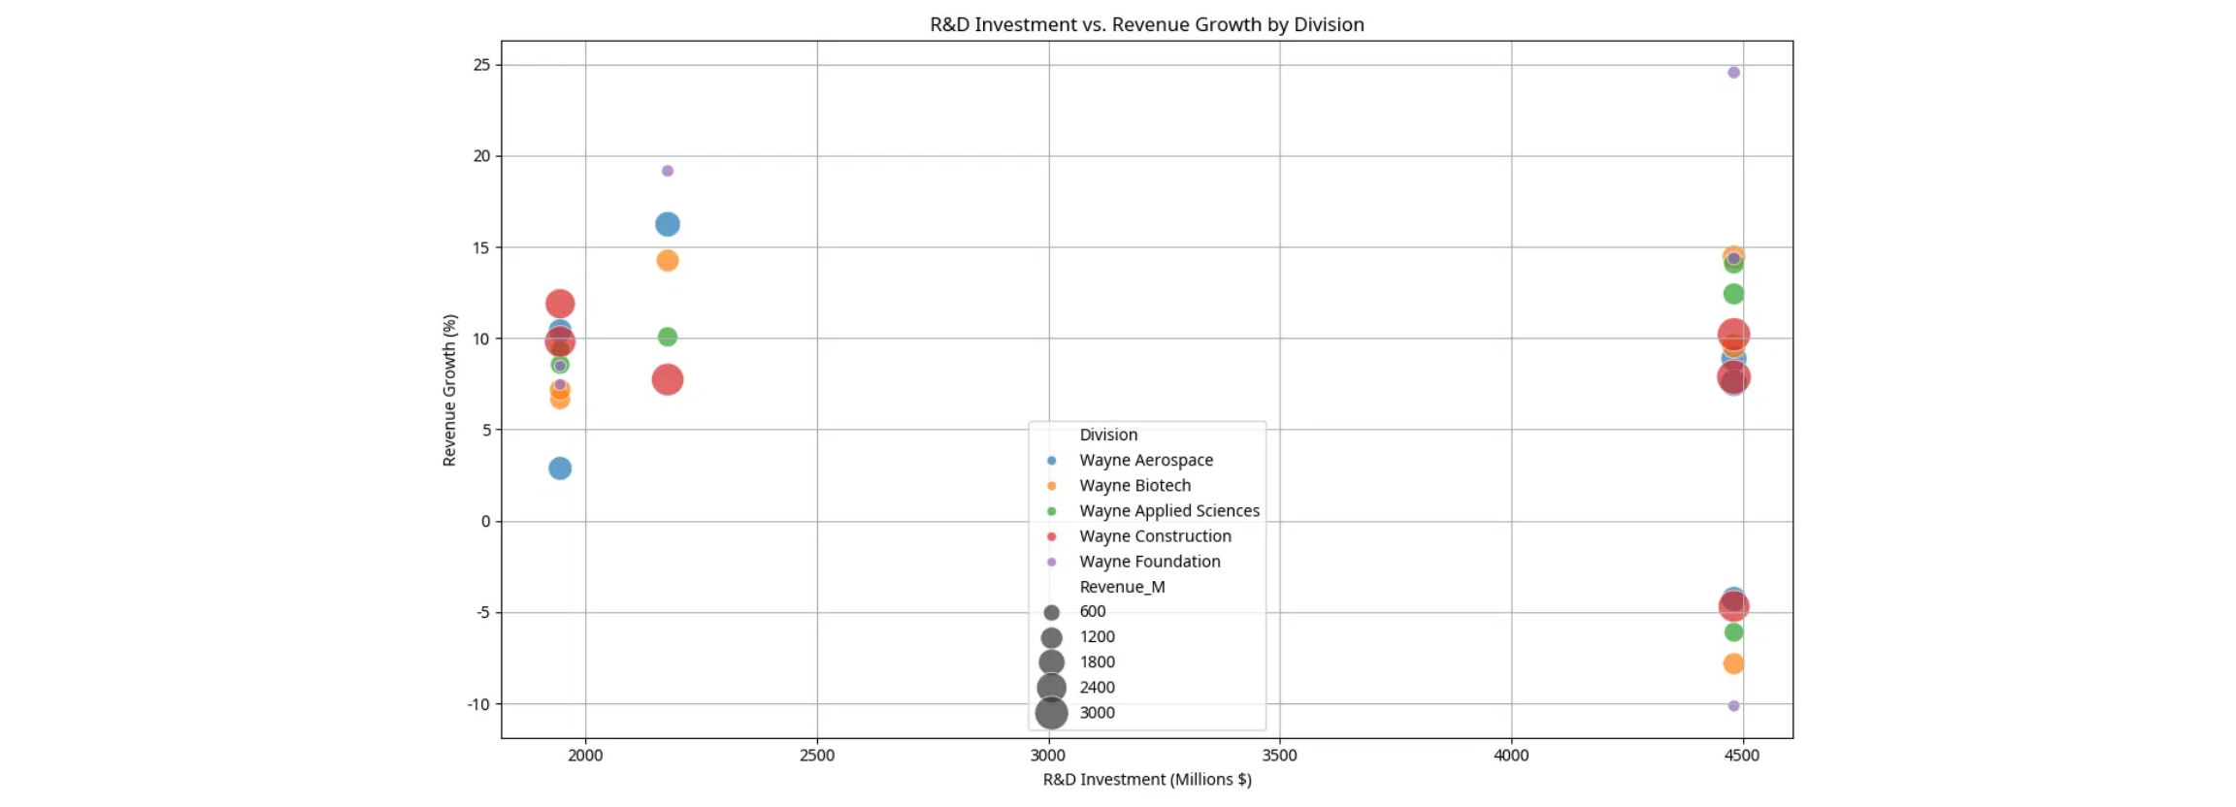
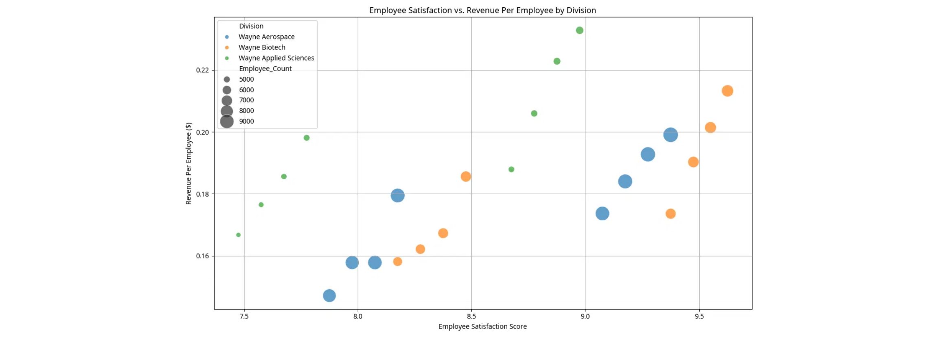







Strategic Correlations
Key insights from cross-dataset analysis showing relationships between R&D investment, employee satisfaction, and operational performance
R&D Investment Impact on Growth
Satisfaction-Productivity Relationship
Correlation Insight:
Strong positive correlation between R&D investment and revenue growth across all divisions
HR-Financial Link:
Higher employee satisfaction directly correlates with increased revenue per employee
Strategic Correlations Identified
Cross-Functional Impact Matrix
R&D → Revenue Growth
Impact
Financial
HR
Operations
12.8% R&D investment ratio drives 18.2% revenue growth
R&D
High
Medium
High
Satisfaction → Productivity
HR
High
High
Medium
8.7/10 satisfaction correlates with $156K revenue/employee
Security
Medium
High
High
Security → Safety
Supply
High
Medium
High
Wayne Tech deployments reduce incidents by 35%
Legend:
High = Strong positive correlation, Medium = Moderate correlation, Low = Weak correlation
Quality → Efficiency
94.2% quality score with 8.2x inventory turnover
Strategic Correlation Insights
Investment Efficiency
Human Capital Value
Operational Synergy
R&D investments show strong ROI across all divisions
Employee satisfaction directly drives productivity gains
Cross-functional initiatives amplify overall performance
Strategic Insight:
Strong correlations across all business functions demonstrate the interconnected nature of
Wayne Enterprises' success, with R&D investment and employee satisfaction as key performance drivers.

Slide 8

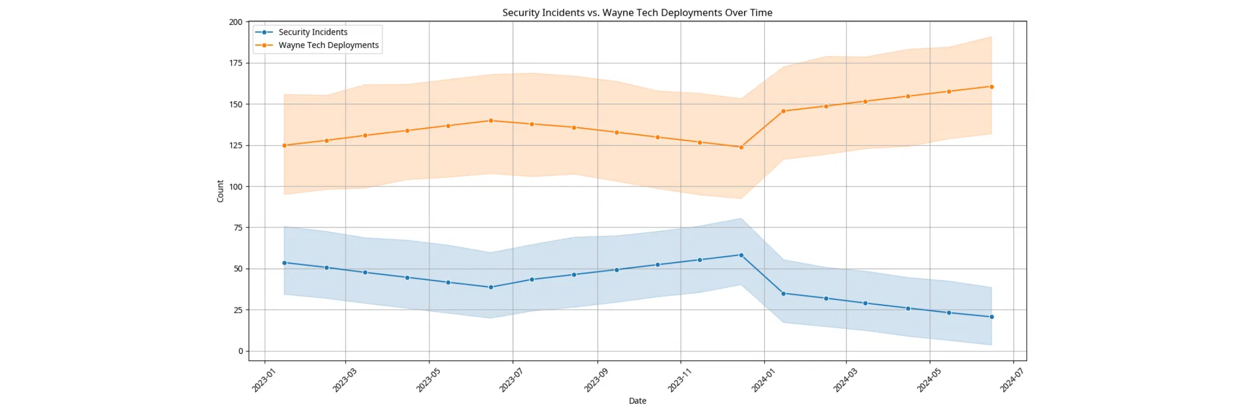
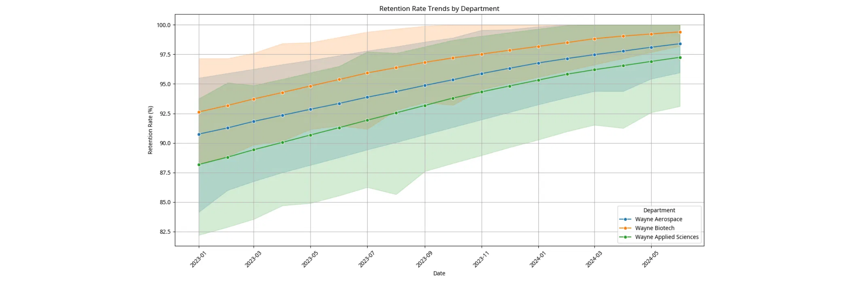










Predictive Analytics & Future Outlook
Forecasting models and trend analysis indicating continued growth potential and areas requiring strategic attention
Security Incident Forecasting
Employee Retention Trends
Predictive Model:
Continued Wayne Tech deployments projected to reduce incidents by additional 20% in 2025
Retention Outlook:
Upward trend indicates potential for 96%+ retention rates across all departments by 2025
2025 Growth Projections
Risk Assessment & Mitigation
Revenue Growth
+22%
High Risk
The Narrows security challenges
Aerospace Division
+28%
Medium Risk
Supply chain disruption potential
Biotech Division
+25%
Watch Areas
Construction Division
+19%
R&D timeline adherence
Applied Sciences
+24%
Low Risk
Employee retention stability
Strategic Opportunities 2025-2027
Neural Interface
Quantum Computing
Global Expansion
Sustainability
Commercial launch Q3 2025
Beta testing Q1 2025
Asia-Pacific entry
Carbon neutral by 2026
$2.1B market potential
$1.8B market potential
$3.2B market potential
ESG leadership position
Future Outlook:
Wayne Enterprises is positioned for accelerated growth with breakthrough technologies
nearing commercialization and strong operational foundations supporting expansion into new markets.

Slide 9









Strategic Recommendations
Data-driven recommendations for resource allocation, risk mitigation, and innovation pipeline optimization
Priority Action Items
Optimal Resource Allocation
Immediate (Q1 2025)
R&D Investment
15% of Revenue
Increase security investment in The Narrows district
Budget: $25M additional allocation
Focus: Neural interfaces (40%), Quantum computing (30%), Defense systems (30%)
HR Development
$85M Annual
Short-term (Q2 2025)
Accelerate neural interface commercialization
Focus: Leadership development, diversity programs, security clearance training
Timeline: Move launch to Q3 2025
Security Operations
$200M Annual
Medium-term (2025-2026)
Expand Gotham Main facility capacity by 40%
Focus: Wayne Tech expansion, community engagement, infrastructure upgrades
Investment: $180M infrastructure upgrade
Supply Chain
$120M Annual
Long-term (2026-2027)
Focus: Sustainability initiatives, automation, quality improvements
Achieve carbon neutrality across all operations
Target: 100% renewable energy by 2026
Risk Mitigation Strategies
Innovation Pipeline Optimization
Security Risk Management
High-Priority Projects
• Deploy additional Wayne Tech units in high-risk areas
Neural Interface
Quantum Computing
• Increase community engagement programs by 50%
Fast-track to market
Beta testing acceleration
• Establish rapid response protocols
Resource Reallocation
Supply Chain Resilience
• Consolidate low-potential projects
• Diversify supplier base across 3 continents
• Increase funding for "Very High" potential projects by 25%
• Implement AI-driven demand forecasting
• Establish innovation incubator program
• Establish strategic inventory buffers
Patent Strategy
R&D Timeline Management
• File 300+ patents in 2025
• Implement agile project management
• Focus on AI and quantum technologies
• Establish milestone-based funding
• Establish defensive patent portfolio
• Create cross-project resource sharing
Implementation Timeline & Success Metrics
Q1 2025
Q2 2025
Q3 2025
Q4 2025
Security investment
Neural interface prep
Product launch
Expansion planning
KPI: -10% incidents
KPI: Beta completion
KPI: $500M revenue
KPI: 25% growth
Strategic Priority:
Focus on high-impact, data-driven initiatives that leverage Wayne Enterprises'
core strengths while addressing identified risk areas and market opportunities.

Slide 10











Conclusion & Next Steps
Summary of key findings and recommended actions for Wayne Enterprises' continued success and growth
Key Findings Summary
Immediate Action Plan (Next 90 Days)
Financial Excellence
Week 1-2: Security Enhancement
18.2% revenue growth with strong profitability across all divisions
• Approve $25M budget for The Narrows
• Deploy 50 additional Wayne Tech units
Human Capital Strength
• Launch community engagement initiative
94.9% retention rate with improving diversity and satisfaction metrics
Innovation Leadership
Week 3-4: R&D Acceleration
$2.1B R&D investment with 42% high commercialization potential
• Fast-track neural interface project
• Allocate additional $50M to high-potential projects
Security Impact
• Establish innovation task force
35% reduction in crime incidents with improved public safety
Month 2: Operational Optimization
Operational Excellence
• Begin Gotham Main facility expansion
94.2% quality scores with ongoing sustainability improvements
• Implement supply chain AI forecasting
• Launch sustainability audit
Month 3: Strategic Planning
• Finalize 2025 expansion strategy
• Establish Asia-Pacific market entry plan
• Complete carbon neutrality roadmap
Success Metrics & KPIs
Strategic Vision 2025-2027
22%
96%
Revenue Growth Target
Employee Retention Target
Global Market Leader
-20%
300+
Expand to 15 new markets with $12B annual revenue
Security Incidents Reduction
Patent Applications
Quarterly Review Schedule
Sustainability Pioneer
• Q1 2025: Security operations assessment
Achieve carbon neutrality and ESG leadership position
• Q2 2025: R&D pipeline review
• Q3 2025: Product launch evaluation
• Q4 2025: Annual performance analysis
Innovation Catalyst
Launch 5 breakthrough technologies, 500+ patents
Board Resolution & Next Steps
Approve Budget
Authorize Initiatives
Schedule Reviews
$605M strategic investment allocation
Security enhancement and R&D acceleration
Quarterly progress assessments
Wayne Enterprises is positioned for unprecedented growth and market leadership through data-driven strategic execution.

